Slide 1

DATA ACQUISITION, PROCESSING, AND INTERPRETATION OF A SINGLE-CHANNEL SURFACE ELECTROMYOGRAPHIC SENSOR WITH MACHINE LEARNING FOR THE SMART WEARABLE THERAPEUTIC GLOVE
BSc in Electronic, Industrial, and Automatic Control Engineering
Advisor: Herminio Martínez García
Co-Advisor: Maziar Ahmadi Zeidabadi
Author: Alexander Ehrich Zapardiel
Notes:
https://pixabay.com/en/achievement-agreement-business-3481967/

Slide 2
Thesis Presentation Outline
01.
Introduction
02.
Data Acquisition
03.
Data Processing & Interpretation
04.
Data Classification
05.
Results
06.
Conclusions & Future Improvements
Notes:
https://pixabay.com/en/books-science-shelf-library-book-408220/

Slide 3
Introduction
01
02
03
Motivation
Scope
Targets
Personal challenge
First AI steps
Electromyography
Hardware & Firmware
Data Acquisition
Machine Learning
Software
Data Processing
Data Interpretation
Data Classification
Own data acquisition process
Real-time data storing
Process the obtained data
Design different ML classification models and compare them
3

Slide 4
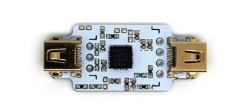

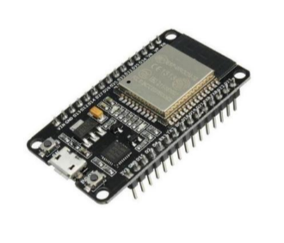

Data Acquisition: Hardware & Firmware
01. Initialising
sEMG sensor (1)
Output range: ±1,64 mV
VCC: 3V
02. Connection to Wi-Fi & Firebase
03. Reading data
ESP32 (2)
Wi-Fi module
Bluetooth module
VCC: 3.3 and 5 V
ADC resolution: 8 bit
04. Sending data
Sources:
[1] pluxbiosignals.com
[2] leantec.es
4

Slide 5
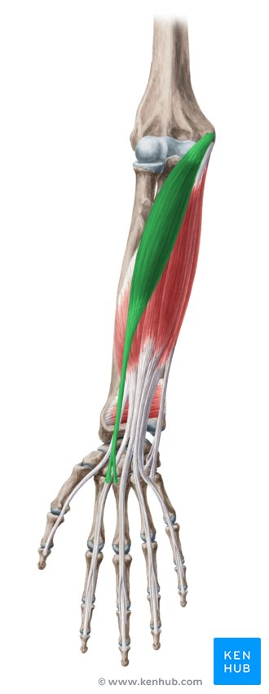
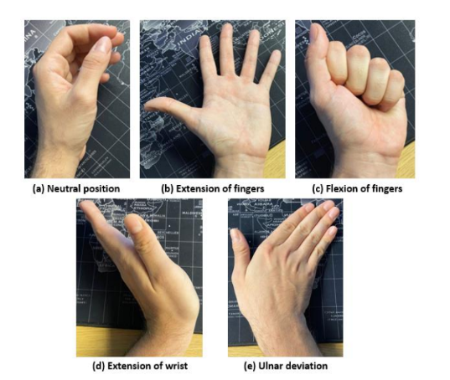
Data Acquisition: Hand-wrist gestures
REF
IN+
IN-
Chosen gestures
Radial carpal extensor (1)
Sources:
[1] Kenhub.com
5

Slide 6
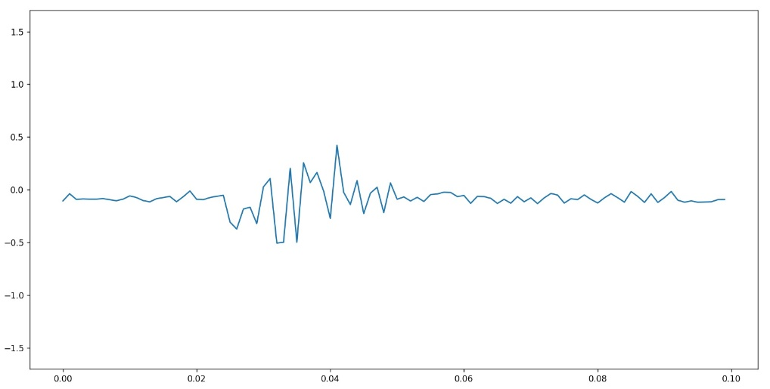
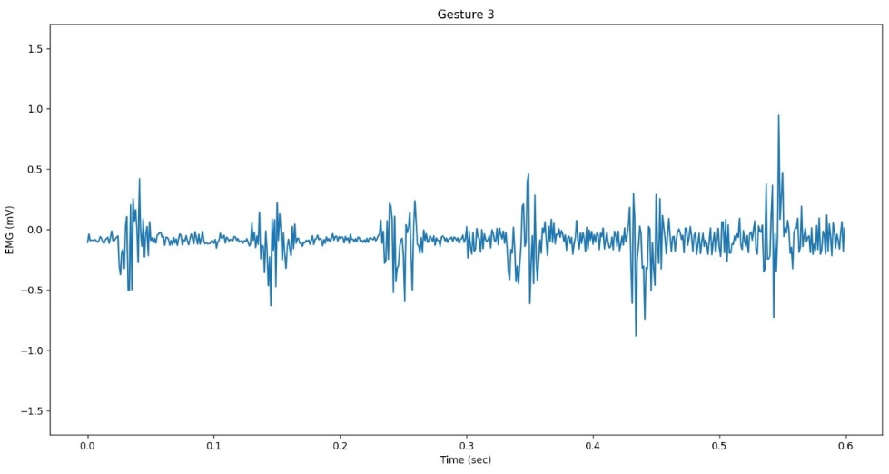
Data Acquisition: Measuring process
1 repetition = 100 data values
Resting period
Resting period
01
Prepare patient (electrodes & explain process)
02
Activation period
Run code & acquisition starts
1 gesture/patient = 600 data values
03
Repeat process 3 times per arm
04
Finish and remove electrodes
Rep. 1
Rep. 2
Rep. 3
Rep. 4
Rep. 5
Rep. 6
1 patient = 3000 data values
Total patients = 90000 data values
6

Slide 7
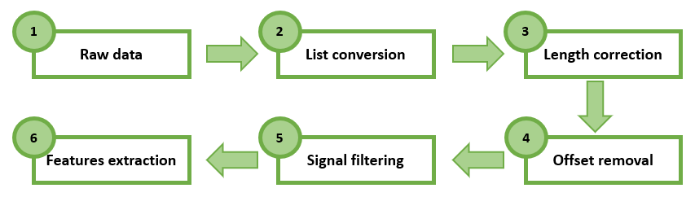
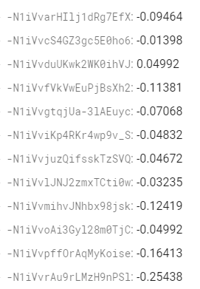

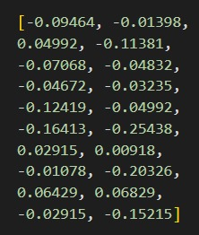
Data Processing & Interpretation
1
2
7

Slide 8

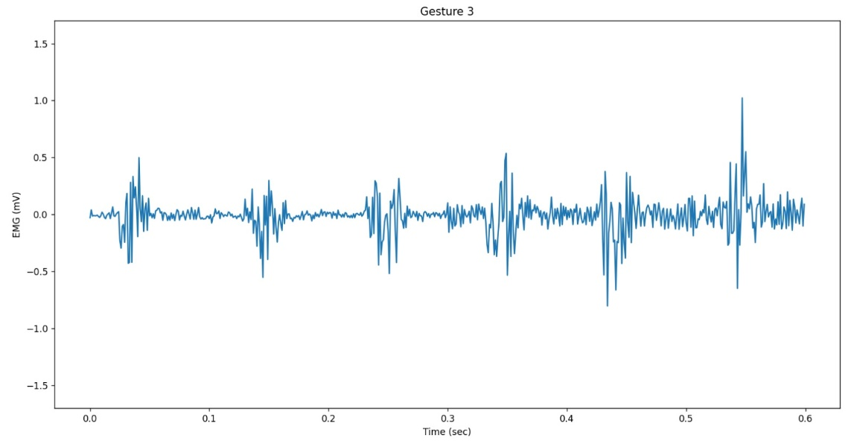
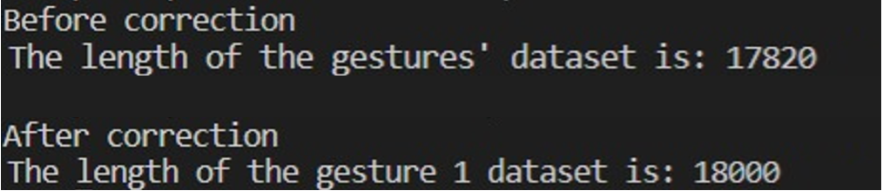
Data Processing & Interpretation
3
4
8

Slide 9
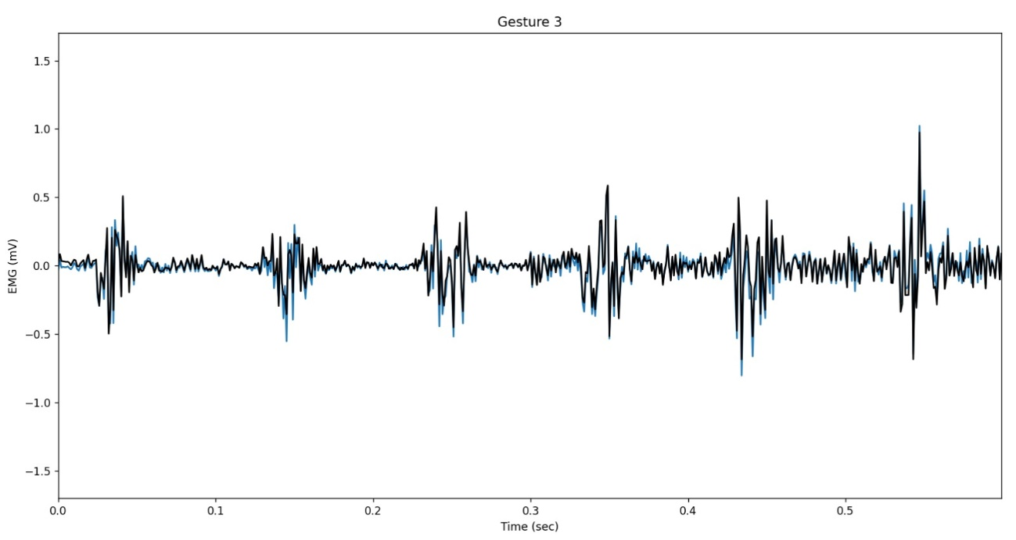
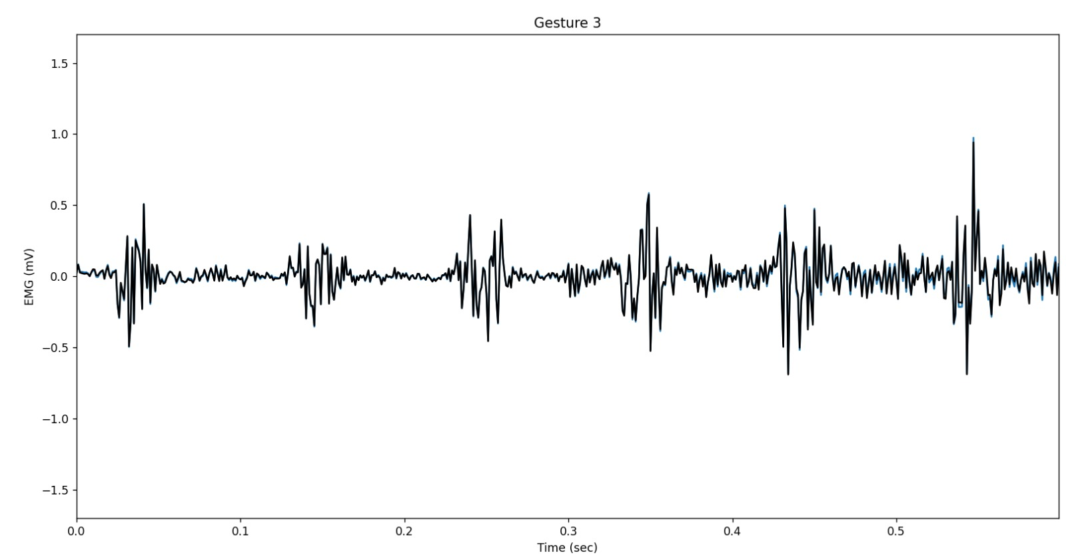
Data Processing & Interpretation
5
9

Slide 10
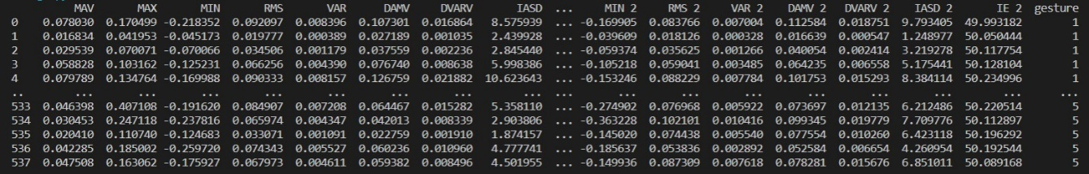
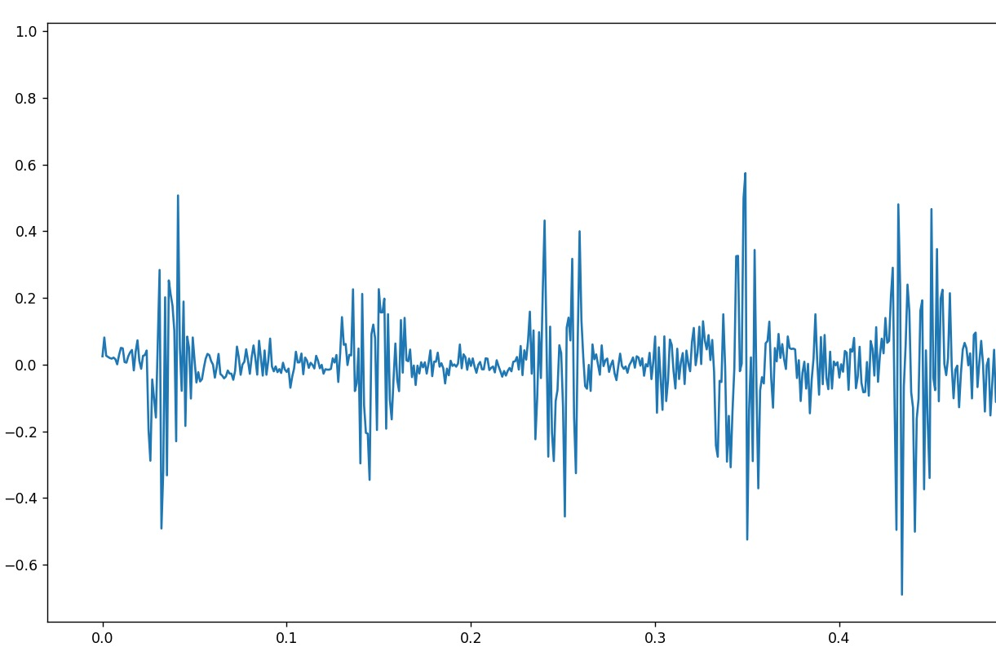
Data Processing & Interpretation
MAX1,1
MAX2,1
MAX3,1
MIN4,1
MIN5,1
MAX1,2
MAX2,2
MAX3,2
MIN4,2
MIN5,2
Sampling data in 2 parts
MAV, MAX, MIN
Features
RMS, VAR
DAMV, DVARV, IASD, IE
Rep. 1
Rep. 2
Rep. 3
Rep. 4
10

Slide 11
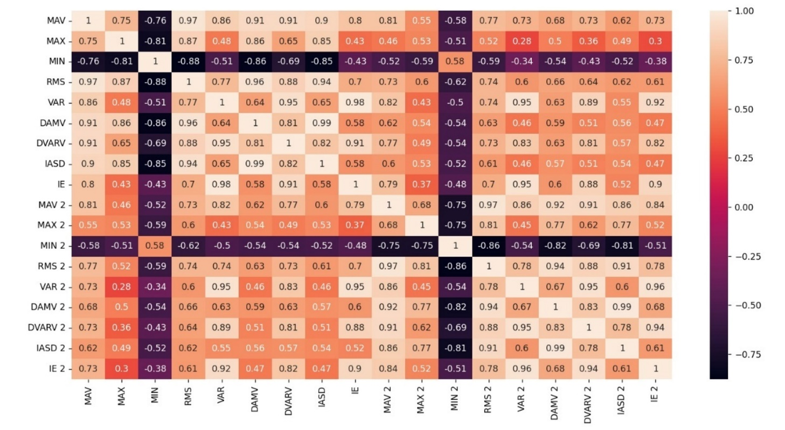
Data Processing & Interpretation
Correlation Matrix from sampled data in 2
11

Slide 12
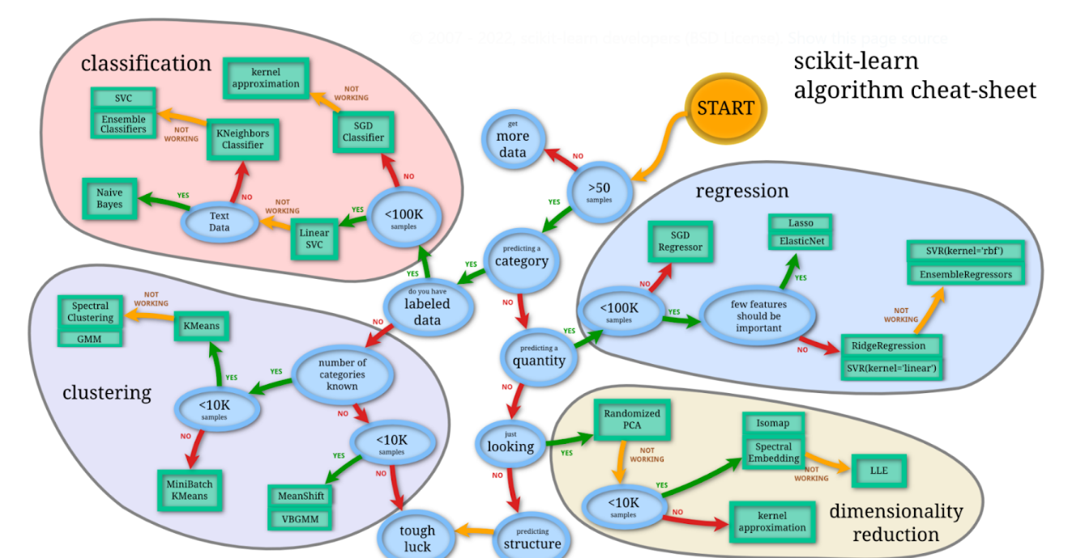
Data Classification
3
1
Logistic Regression
2
Source:
[1] scikit-learn.org
12

Slide 13
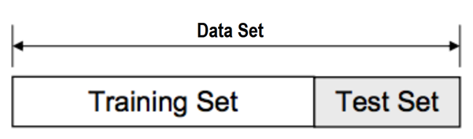
Data Classification
Train-Test Split
(1)
80% Training 20% Test
67% Training 33% Test
Model Accuracy
(Test Accuracy)
Source:
[1] medium.com
13

Slide 14
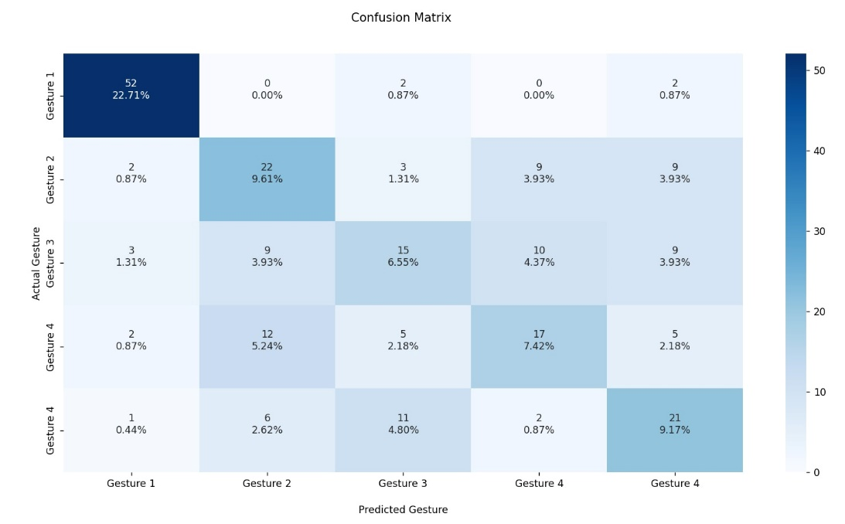
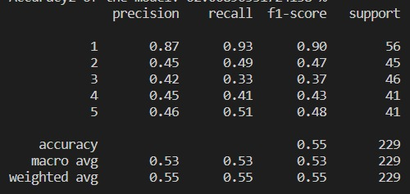
Results
Efficiency and Accuracy Evaluators
1. Training Accuracy
3. Confusion Matrix
2. Classification Report
14

Slide 15
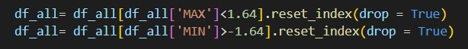
Results
Implementation & Final Results Comparison
Implementation
 | Logistic Regression |  | SVC |  | KNN
Test-size | 20% | 33% | 20% | 33% | 20% | 33%
Test Accuracy (%) | 60,80 | 55,52 | 57,95 | 54,83 | 51,70 | 51,03
Train Accuracy (%) | 56,13 | 56,12 | 62,11 | 61,56 | 64,39 | 62,76
Accuracy Gap (%) | 4,67 | 0,60 | 4,16 | 6,73 | 12,69 | 11,73
Classification Report |  | Test-size
 |  | 20% |  |  |  |  | 33%
Gesture |  | 1 | 2 | 3 | 4 | 5 | 1 | 2 | 3 | 4 | 5
Logistic Regression | Precision | 0,90 | 0,44 | 0,54 | 0,59 | 0,52 | 0,89 | 0,37 | 0,49 | 0,47 | 0,49
 | Recall | 0,97 | 0,34 | 0,48 | 0,47 | 0,76 | 0,93 | 0,28 | 0,39 | 0,47 | 0,68
 | F1-score | 0,93 | 0,39 | 0,51 | 0,53 | 0,62 | 0,91 | 0,32 | 0,43 | 0,47 | 0,57
SVC | Precision | 0,91 | 0,38 | 0,50 | 0,56 | 0,49 | 0,93 | 0,31 | 0,55 | 0,43 | 0,52
 | Recall | 0,89 | 0,23 | 0,42 | 0,57 | 0,76 | 0,86 | 0,21 | 0,31 | 0,60 | 0,75
 | F1-score | 0,90 | 0,29 | 0,46 | 0,57 | 0,60 | 0,89 | 0,25 | 0,39 | 0,50 | 0,61
KNN | Precision | 0,94 | 0,40 | 0,26 | 0,59 | 0,44 | 0,96 | 0,37 | 0,29 | 0,43 | 0,52
 | Recall | 0,92 | 0,46 | 0,32 | 0,42 | 0,44 | 0,92 | 0,46 | 0,27 | 0,40 | 0,50
 | F1-score | 0,93 | 0,43 | 0,29 | 0,49 | 0,44 | 0,94 | 0,41 | 0,28 | 0,42 | 0,51
15

Slide 16
Conclusions & Future Improvements
01
03
More Data
Own Signal Monitoring
02
04
Multi-Channel sEMG
Deep Learning
Good quality and quantity of data are a must
Pre-processing the signal is vital for good quality features
First experience and project on this topic, helped to decide my next professional steps
16

Slide 17
Thanks for your attention.
Notes:
You can safely remove this slide. This slide design was provided by SlideModel.com – You can download more templates, shapes and elements for PowerPoint from http://slidemodel.com

Slide 18
MAV: Mean Absolute Value (for each segment).
MAX: Maximum value for each segment.
MIN: Minimum value for each segment.
RMS: Quadratic mean of each segment.
VAR: Variance, to obtain the dispersion of the data points from the mean of the segment.
DAMV: Difference Absolute Mean Value, average absolute difference of two consecutive values of the signal divided by the length of the segment.
DVARV: Difference Variance Version, calculates the variance but applying the concept of the DAMV of calculating the difference between a value and its following.
IASD: Integrated Absolute of Second Derivative, calculates the relative change of the second derivative of the signal.
IE: Integrated Exponential, this feature amplifies large values and to suppresses the small ones by calculating the summation of the exponential value of the signal data values of the segment.
Features

Slide 19
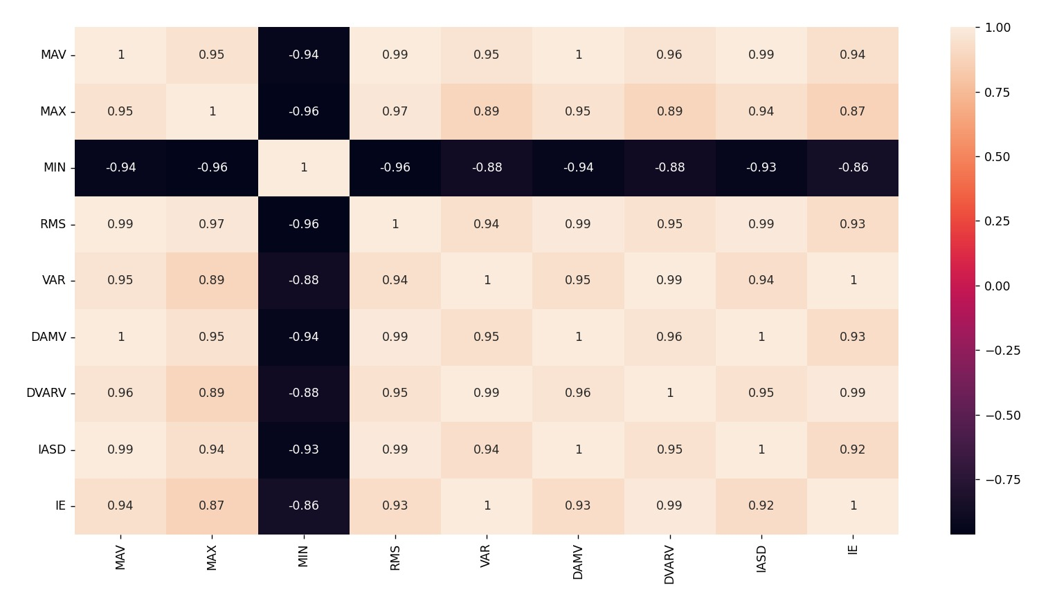
Data Processing & Interpretation
Correlation Matrix from original data

Slide 20
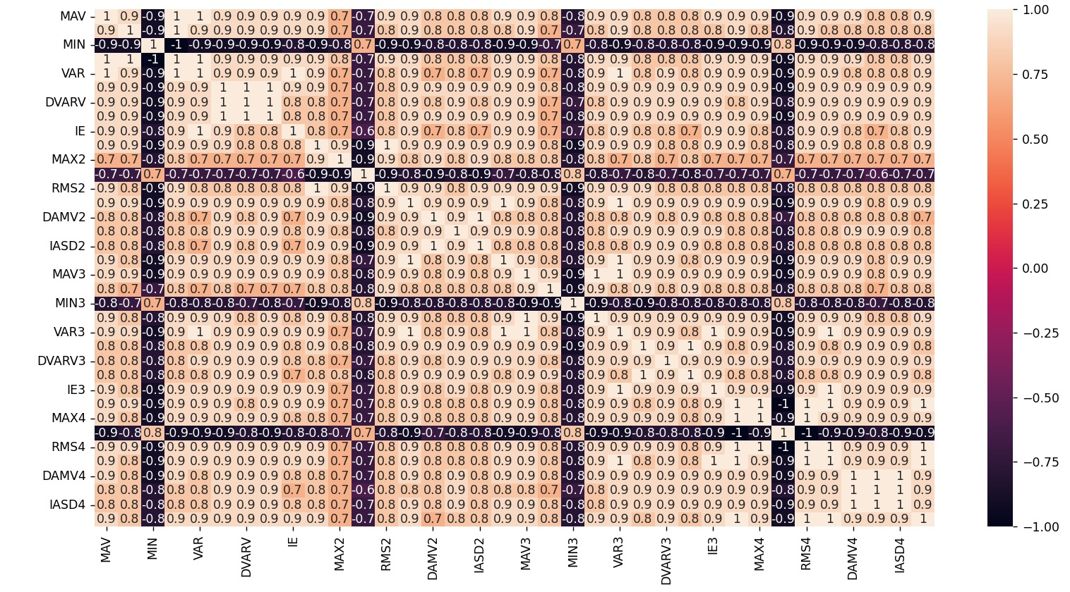
Data Processing & Interpretation
Correlation Matrix from sampled data in 4

Slide 21
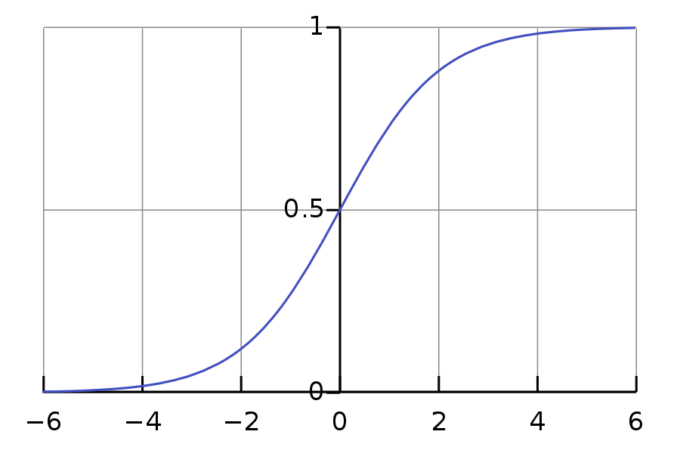
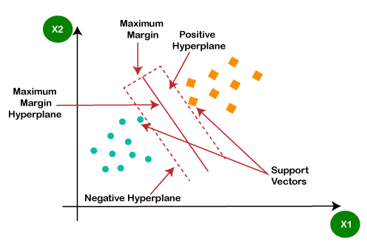
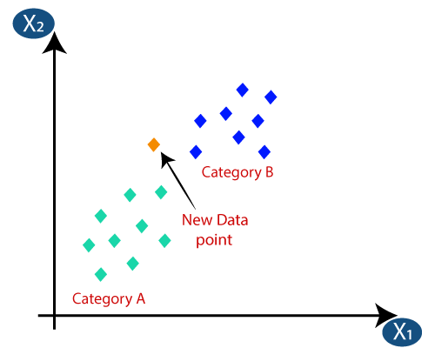
Data Classification
Chosen ML Classification Models
[1]
1
Logistic Regression
[2]
2
Support Vector Classifier
[3]
3
K-Nearest Neighbours

Slide 22
Results
First Results Comparison
 | Logistic Regression |  | SVC |  | KNN
Test-size | 20% | 33% | 20% | 33% | 20% | 33%
Test Accuracy (%) | 50,56 | 53,54 | 50,00 | 49,49 | 48,33 | 49,16
Train Accuracy (%) | 54,46 | 53,07 | 54,18 | 53,24 | 66,30 | 65,39
Accuracy Gap (%) | 3,90 | 0,47 | 4,18 | 3,75 | 17,97 | 16,23
Classification Report |  | Test-size
 |  | 20% |  |  |  |  | 33%
Gesture |  | 1 | 2 | 3 | 4 | 5 | 1 | 2 | 3 | 4 | 5
Logistic Regression | Precision | 0,76 | 0,52 | 0,26 | 0,47 | 0,42 | 0,75 | 0,60 | 0,40 | 0,50 | 0,40
 | Recall | 0,91 | 0,37 | 0,17 | 0,50 | 0,62 | 0,93 | 0,44 | 0,21 | 0,55 | 0,61
 | F1-score | 0,83 | 0,43 | 0,20 | 0,48 | 0,50 | 0,83 | 0,50 | 0,28 | 0,52 | 0,48
SVC | Precision | 0,88 | 0,58 | 0,33 | 0,48 | 0,36 | 0,84 | 0,83 | 0,46 | 0,34 | 0,36
 | Recall | 0,80 | 0,16 | 0,17 | 0,78 | 0,71 | 0,84 | 0,08 | 0,18 | 0,74 | 0,75
 | F1-score | 0,84 | 0,25 | 0,22 | 0,60 | 0,48 | 0,84 | 0,14 | 0,26 | 0,54 | 0,49
KNN | Precision | 0,89 | 0,41 | 0,24 | 0,45 | 0,45 | 0,87 | 0,39 | 0,26 | 0,43 | 0,46
 | Recall | 0,91 | 0,49 | 0,25 | 0,47 | 0,29 | 0,93 | 0,42 | 0,18 | 0,49 | 0,48
 | F1-score | 0,90 | 0,45 | 0,24 | 0,46 | 0,36 | 0,90 | 0,40 | 0,21 | 0,46 | 0,47

Slide 23

Realtime Evaluation
Signal Recording
Importing Signal
Signal Pre-processing
Features extraction
Classification Model
Output

Slide 24
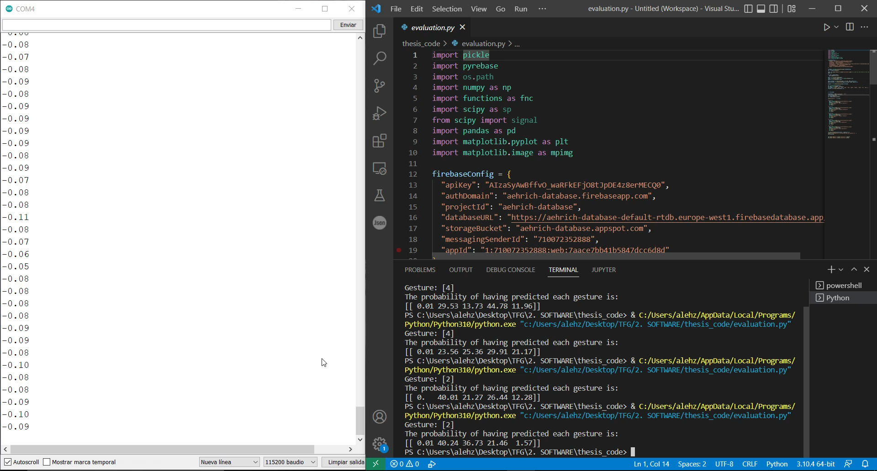
Realtime Evaluation

Slide 25
Future Improvements
01
More Data
04
Own Signal Monitoring
Increase dataset to improve the accuracy of the model.
Create app that stores and monitors the data as all the fabricants do.
02
Multi-Channel sEMG
05
Different Data Acquisition
Use a sensor with different channels to gain precision when it comes to define gestures.
Improve the actual process to reduce the acquisition time and increase the amount of data.
03
Higher ADC resolution
06
Deep Learning
An ADC with higher resolution is reflected in a cleaner signal, with less noise and more defined.
Use Deep Learning to implement a NN and improve the model.

